Slide 1
Intro to Command Line &
Visual Studio Code
© 2024 Web Age Solutions, All rights reserved

Slide 2

1.1 Command Line Crash Course!
In your development process, it is inevitable that you will be required to run some commands in the terminal (or on the "command line" — these are effectively the same thing).
This course will provide an introduction to:
the terminal
the essential commands you'll need to enter into it
© 2024 Web Age Solutions, All rights reserved

Slide 3
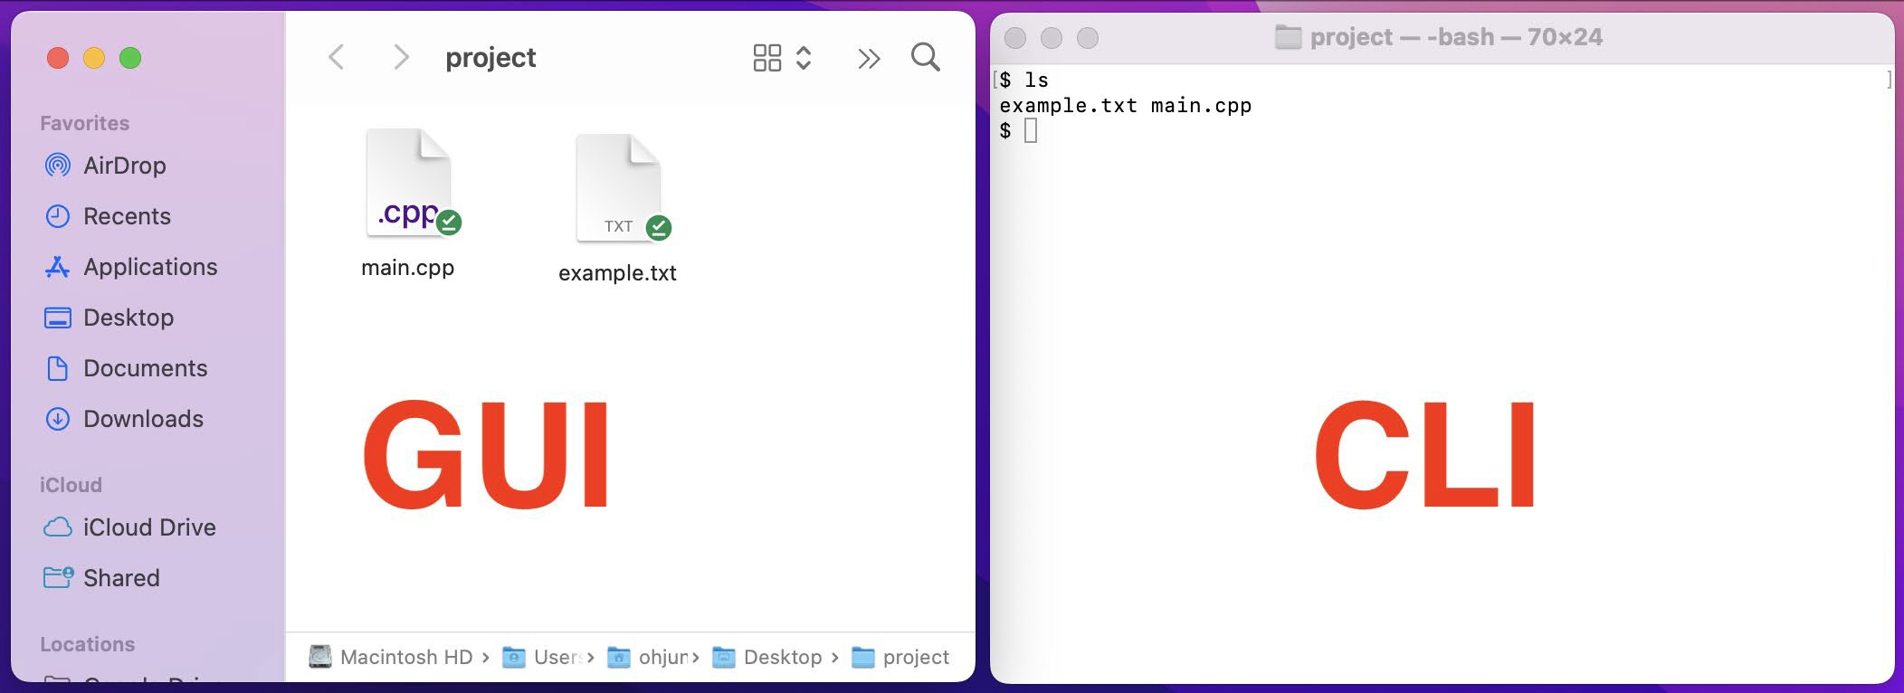
1.2 What is the command line?
The window, which is usually called the command line or command-line interface, is
a text-based application for viewing,
handling, and manipulating files on your computer.
It allows you to interact with the computer’s operating system.
The command line works by typing commands against a prompt, which then gets passed to the operating system of the computer that runs these commands.
It's much like Windows Explorer or Finder on the Mac, but without the graphical interface.
Other names for the command line are: cmd, CLI, prompt, console or terminal. (Generally, you'll find these terms used interchangeably. )

Slide 4
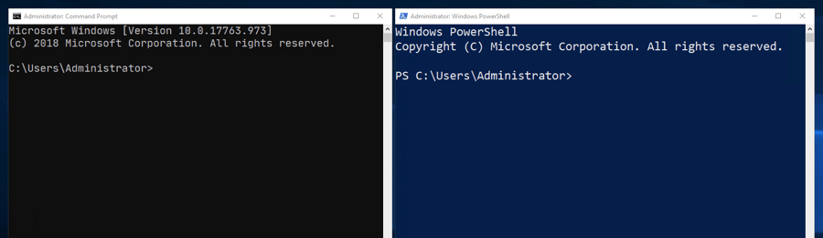
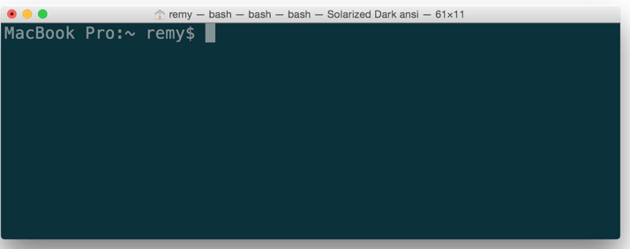
1.3 How to access the terminal?
How to get access to the terminal depends on your operating system.
•
Linux/Unix
- Linux/Unix systems have a terminal available by default, listed among your Applications.
•
macOS
- macOS has a system called Darwin that sits underneath the graphical user interface. Darwin is a Unix-like system, which provides the terminal,
and access to the low-level tools
The terminal is available on macOS at Applications/Utilities/Terminal.
•
Windows
- As with some other programming tools, using the terminal (or command line) on Windows has traditionally not been as simple or easy as on
other operating systems. But things are getting better.
Windows has traditionally had its own terminal-like program called cmd ("the command prompt") for a long time. It is equivalent to the old-style Windows DOS prompt.
© 2024 Web Age Solutions, All rights reserved

Slide 5
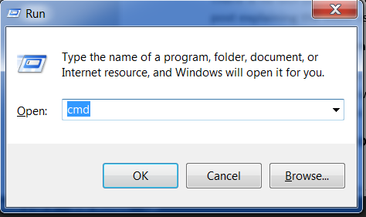
1.4 Open the command-line interface - Windows
Depending on your version of Windows and your keyboard, you can use one of the following to open a command window :
Go to the Start menu or screen and enter "Command Prompt" in the search field.
Go to Start menu → Windows System → Command Prompt.
Go to Start menu → All Programs → Accessories → Command Prompt.
Go to the Start screen, hover your mouse in the lower-left corner of the screen, and click the down arrow that appears (on a touch screen, instead flick up from the bottom of the screen). The Apps page should open. Click on Command Prompt in the Windows System section.
Hold the special Windows key on your keyboard and press the "X" key. Choose "Command Prompt" from the pop-up menu.
Hold the Windows key and press the "R" key to get a "Run" window. Type "cmd" in the box and click the OK key.
© 2024 Web Age Solutions, All rights reserved

Slide 6
1.5 Basic Built-In Terminal Commands
These are a few of the things you will need to be able to do with the command line.
Navigate your computer's file system along with base-level tasks such as create, copy, rename, and delete.
Move around your directory structure: cd
Create directories: mkdir Copy files or directories: cp Move files or directories: mv Delete files or directories: rm
Download files found at specific URLs: curl
Search for fragments of text inside larger bodies of text: grep
View a file's contents page by page: less, cat
Manipulate and transform streams of text (for example changing all the instances of <div>s in an HTML file to <article>): awk, tr, sed
© 2024 Web Age Solutions, All rights reserved

Slide 7
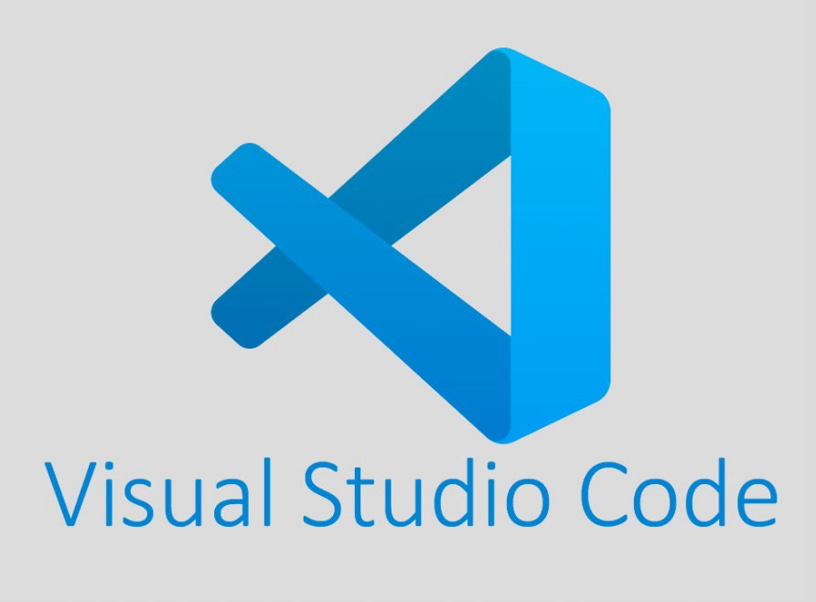
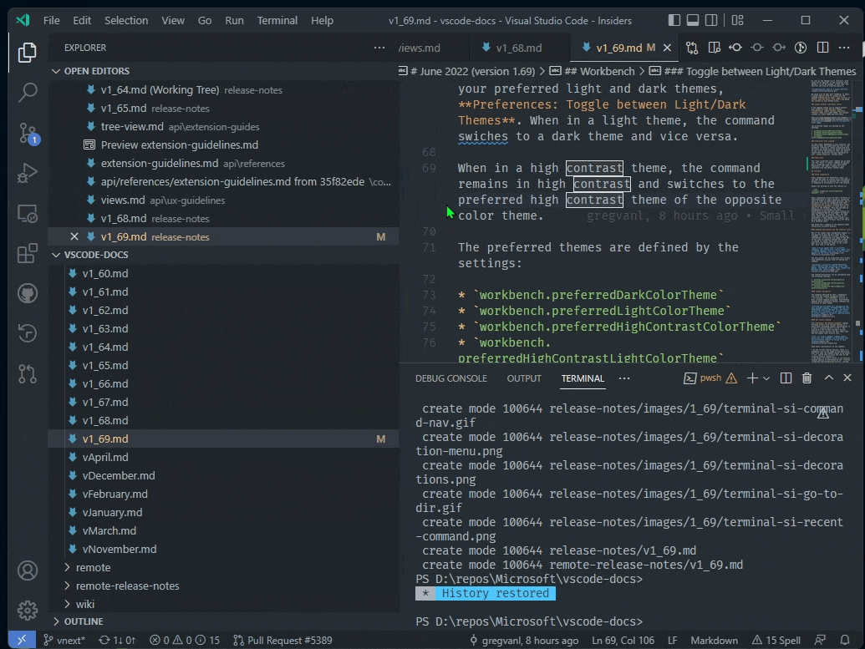
1.6 Visual Studio Code
To be a strong developer you need to be comfortable with your integrated development environment (IDE).
An integrated development environment (IDE) is a software application that helps programmers develop applications.
•
Visual Studio Code is a popular choice.
Visual Studio is currently installed on your VM’s.
© 2024 Web Age Solutions, All rights reserved

Slide 8
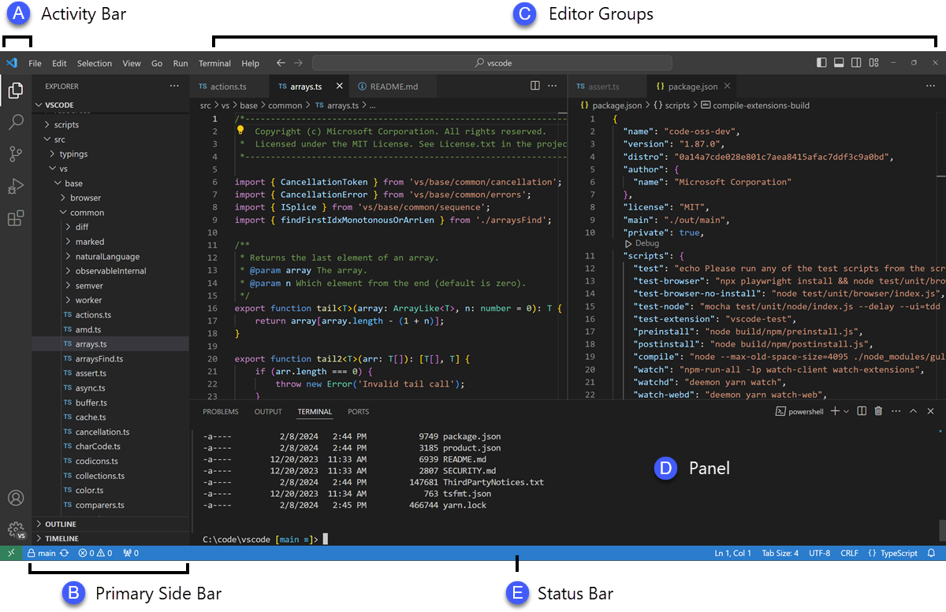
1.7 VS Code Basic Layout
The user interface is divided into five main areas:
Editor - The main area to edit your files. You can open as many editors as you like side by side vertically and horizontally.
Primary Side Bar - Contains different views like the Explorer to assist you while working on your project.
Status Bar - Information about the opened project and the files you edit.
Activity Bar - Located on the far left-hand side. Let's you switch between views and gives you additional context-specific indicators, like the number of outgoing changes when Git is enabled. You can change the position of the Activity Bar.
Panel - An additional space for views below the editor region. By default, it contains output, debug information, errors and warnings, and an integrated terminal. The Panel can also be moved to the left or right for more vertical space.

Slide 9


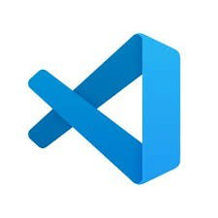

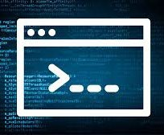
Have fun with your tasks this week!
Remember you can always ask questions in the Basecamp message board. If you run into trouble, or need help, reach out and I can help.
Your tasks this week!
Be sure to remember which parts of the course were the most difficult.
We can review those at our next Monday session.
© 2024 Web Age Solutions, All rights reserved
9

